Slide 1
Embedded Picture Mnemonic Grids
Why is identifying a first sound important?
The ability to isolate the first sound in a word is highly related to later reading acquisition and reading achievement.
Why use embedded picture mnemonics?
Embedded picture mnemonics are a research-based way to teach children about letters and the sounds they represent. They are letter cards with a picture of a key word embedded directly in a letter, such as the letter z made out of a zipper, or the letter r made out of a road. Research indicates that students learn letter-sound correspondences better when they are taught with embedded picture mnemonics (Ehri et al., 1984).
Possible ways to use these grids
Roll and Read
Three in a row
Connect 4 style
Answer Key:
a - apple, b - banana, c - cat, d – dinosaur, e – echo, f – fish, g – goose, h – horse, i – itch, j – jelly beans, k – keys, l – leaf, m – mittens, n – net, o – octopus, p – pumpkin, qu – quarter, r – road, s – sandwich, t – tiger, u – umbrella, v – volcano, w – worm, x – box, y – yoyo, z - zipper

Slide 2





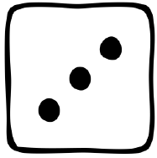
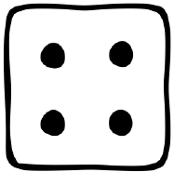
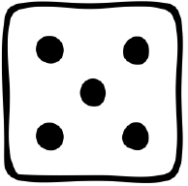
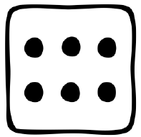
Notes:
Begin after first 3 lessons
<number>

Slide 3

Notes:
New – t Review - sma
<number>

Slide 4

Notes:
New – p New Review – t Old Review - sma
<number>

Slide 5

Notes:
New – f New Review – p Old Review - tsma
<number>

Slide 6

Notes:
New – i New Review – f Old Review - ptsma
<number>

Slide 7

Notes:
New – n New Review – i Old Review - fptsma
<number>

Slide 8

Notes:
New – o New Review – n Old Review - ifptsma
<number>

Slide 9

Notes:
New – d New Review – o Old Review -nifptsma
<number>

Slide 10

Notes:
New – c New Review – d Old Review -onifptsma
<number>

Slide 11

Notes:
New – u New Review – c Old Review -donifptsma
<number>

Slide 12

Notes:
New – g New Review – u Old Review -cdonifptsma
<number>

Slide 13

Notes:
New – b New Review – g Old Review -ucdonifptsma
<number>

Slide 14

Notes:
New – e New Review – b Old Review -gucdonifptsma
<number>

Slide 15

Notes:
New – k New Review – e Old Review -bgucdonifptsma
<number>

Slide 16

Notes:
New – h New Review – k Old Review -ebgucdonifptsma
<number>

Slide 17

Notes:
New – r New Review – h Old Review -kebgucdonifptsma
<number>

Slide 18

Notes:
New – l New Review – r Old Review -hkebgucdonifptsma
<number>

Slide 19

Notes:
New – w New Review – l Old Review -rhkebgucdonifptsma
<number>

Slide 20

Notes:
New – j New Review – w Old Review -lrhkebgucdonifptsma
<number>

Slide 21

Notes:
New – y New Review – j Old Review -wlrhkebgucdonifptsma
<number>

Slide 22

Notes:
New – x New Review – y Old Review -jwlrhkebgucdonifptsma
<number>

Slide 23

Notes:
New – qu New Review – x Old Review -yjwlrhkebgucdonifptsma
<number>

Slide 24

Notes:
New – v New Review – qu Old Review -xyjwlrhkebgucdonifptsma
<number>

Slide 25
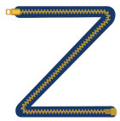
Notes:
New – z New Review – v Old Review -quxyjwlrhkebgucdonifptsma
<number>

Slide 26
Notes:
Review 1st 6 letters - fptsma
<number>

Slide 27
Notes:
Review 2nd group of 6 letters (inodcu) with Review of 1st set (amstpf)
<number>

Slide 28
Notes:
Review 3rd group of 6 letters (gbekhr) with Review of 2nd set (inodcu)
<number>

Slide 29
Notes:
Review remaining letters (lwjyxquvz) Old review of 3rd set (gbekhr)
<number>

Slide 30
Notes:
All Letters, extra spaces given to commonly confused letters: vowels, b/d, p/qu, y
<number>

